Slide 1

Your Next Online Grocery Shopping Platform - iGro

Slide 2

Team
Denis Remesnik JOB TITLE
Blalala
Denis Remesnik JOB TITLE
Blalala
Denis Remesnik JOB TITLE
Blalala
Denis Remesnik JOB TITLE
Blalala

Slide 3

Overview
Problem statement
About 80% of the US adults did not opt for online grocery shopping even during the pandemic.
Positioning
Unlike other competitors, who do not provide the option of convenient product selection based on the desired recipe:
iGro provides a service for purchasing products based on recipes from the specific store website and its ingredients exclusive to the store

Slide 4
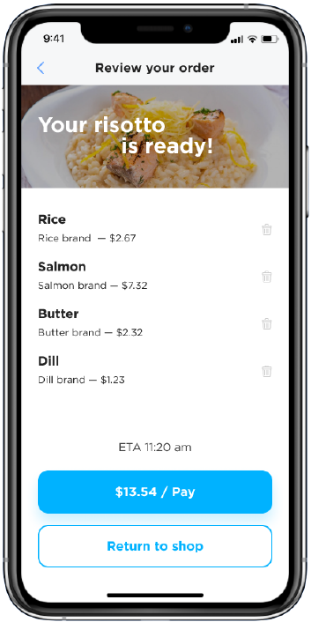
Value proposition
iGro offers a convenient service to buy recipe-based groceries of their favorite brands from their favorite stores
Gives an easy way to decide on the choice of products for cooking their favorite dish

Slide 5
Case assumption
Target audience
Browsing working professionals in and around Seattle looking for online recipe-based order.
Subscription model
Membership subscription model for the customers using the app/website.
Target market
Deliver within 25-mile radius from Seattle center for the first year (partnered with Uber Eats).

Slide 6
Subscription model
Month
Six month
Annual
10
55
99
$
$
$
50
50
50
30
30
30
60
60
60
70
70
70
90
90
90
Sign Up
Sign Up
Sign Up

Slide 7
Market objective
Build brand awareness
Increase business
New product introduction

Slide 8


Target Audience Persona
 | Jessica | Kim
Health conscious | Career woman who’s on the go Wants to be assured its of high quality | On the go, hasn’t put much effort into cooking since he has limited time. Likes cooking
Limited time for shopping | Busy Working Schedule | Limited time to cook healthy meal
Travelers who prefer cooking their own food | Likes to travel | Travels due to business most of the times
Trying various cuisines | Follows a healthy diet | Loves trying different cuisines – adventurous
Food connoisseurs | Likes to critique food | Likes to try different foods/cuisine
Struggles with online shopping | Incorrect brand/items, Late delivery, Not so fresh | Not tech savvy, Requires training to use applications, late delivery

Slide 9
Persona filter
Health Conscious
Interested in trying their various cuisines
Travelers who prefer cooking their own food
Limited time for shopping
Food Connoisseurs

Slide 10
Marketing strategy
Social Media
Search engine optimization
Search engine marketing
Billboards and posters

Slide 11



Brand matrix
LOW VALUE 1
Other local business
LOW VALUE 2
LOW VALUE 2
LOW VALUE 2

